Slide 1



Slide 2


Slide 3
PRICED

Slide 4


Slide 5
Pricing Strategies
Priced Right = Offers
Showings & No Offers 4-6% Off
Low Showings 6-12% off
Drive By’s Only = 12+% Off

Slide 6
SHOWS

Slide 7
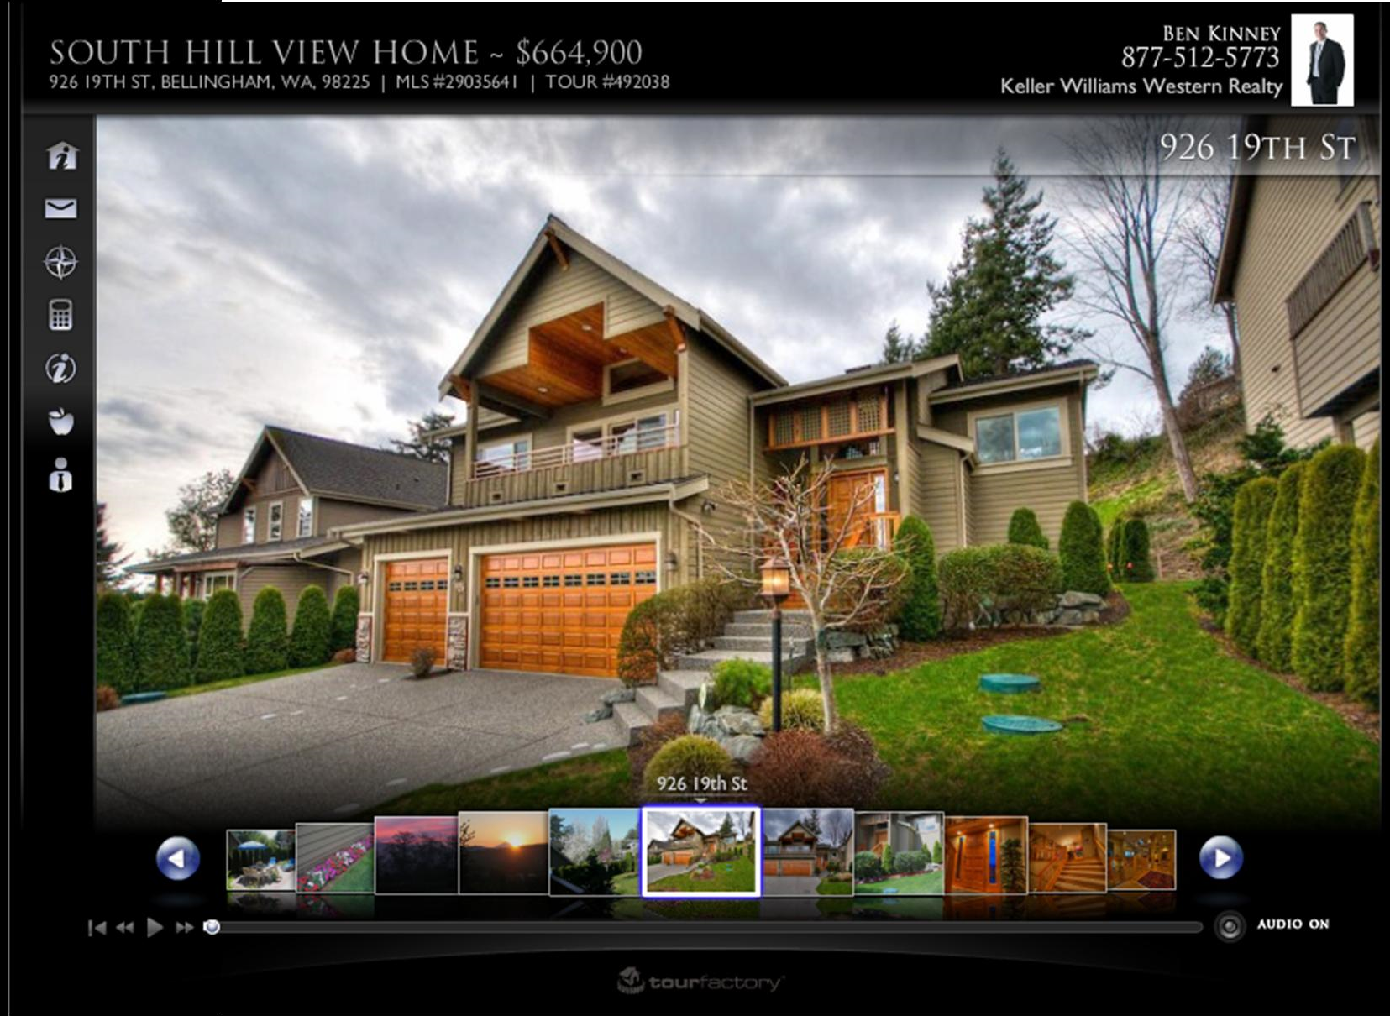

Slide 8
MARKETED

Slide 9

NAR Profile of Buyers & Sellers
How buyers found their home

Slide 10
Real Estate
Agents

Slide 11


Agents
Real Estate Agents
35%
Notes:
EXPLAIN THE WHEEL

Slide 12
Agent to Agent
Electronic Flyers
Paper Flyers
Virtual Tours
Realtor & Office Meetings
Constant Communications
Notes:
EXPLAIN THE WHEEL

Slide 13
Online
Marketing

Slide 14


37% First found their home online

Slide 15

Agents

Slide 16
Your Property
Brokerage Websites
National Portals
Classified Services
Search Engines
Social Media
Notes:
EXPLAIN THE WHEEL

Slide 17
Brokerage
Websites

Slide 18


Slide 19
National
Portals

Slide 20
































Slide 21
Classified
Services

Slide 22


Slide 23
Search
Engines

Slide 24







Slide 25
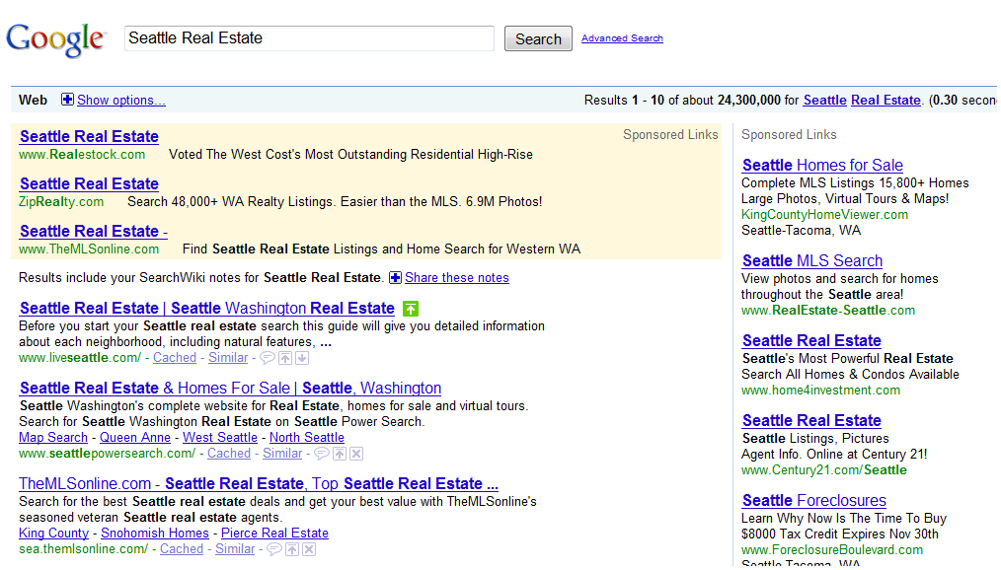

Slide 28
Social
Media

Slide 29







Slide 30
Signs & Flyers

Slide 31


Agents
15%

Slide 32
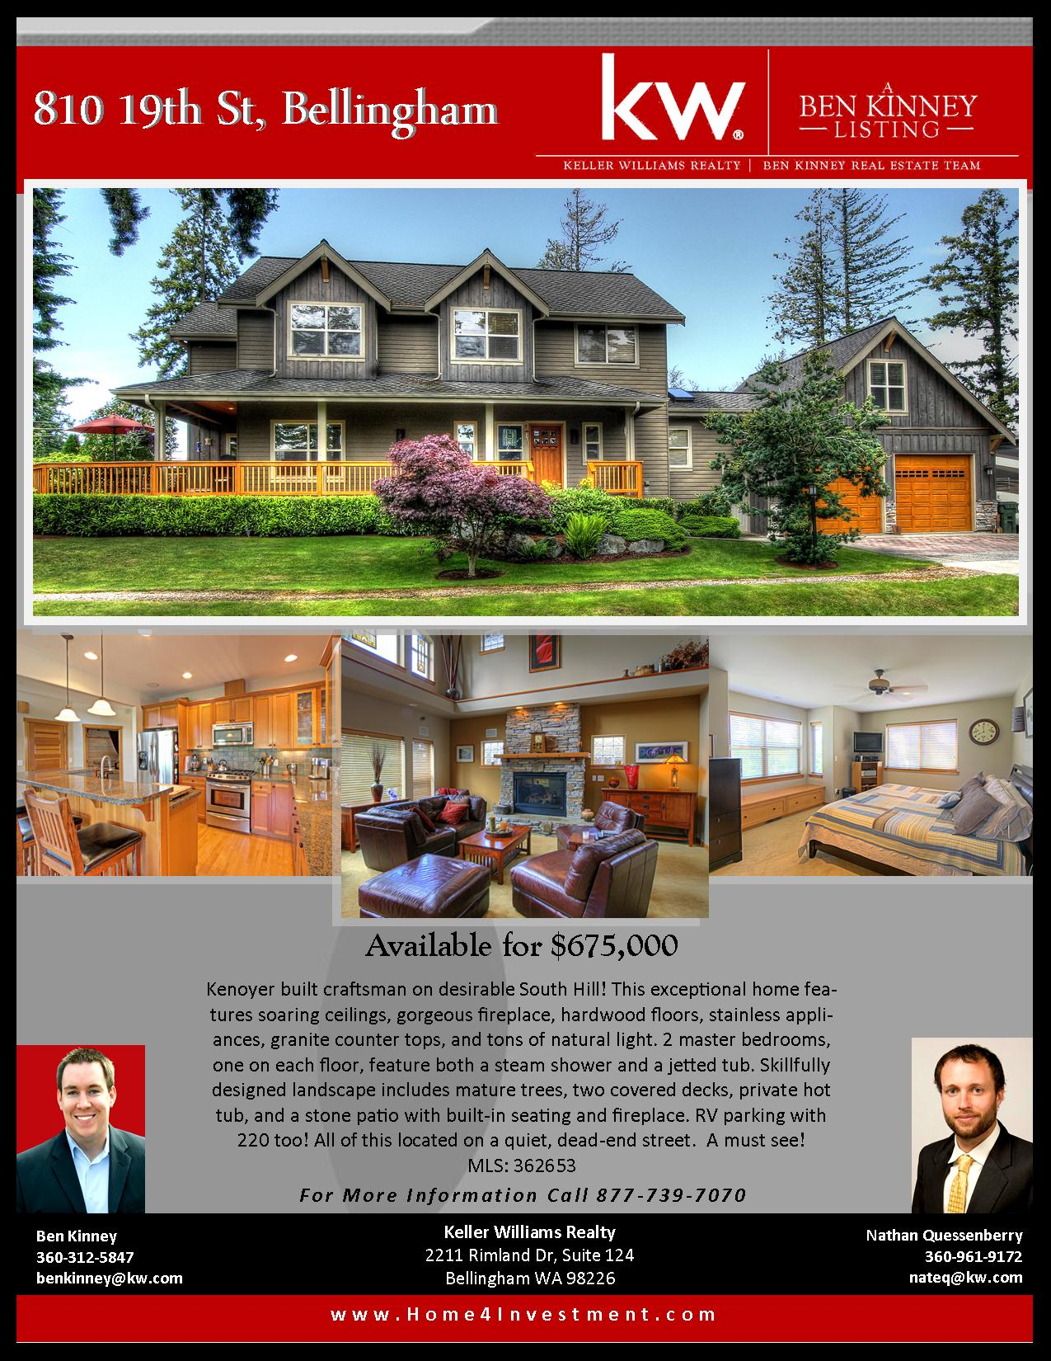
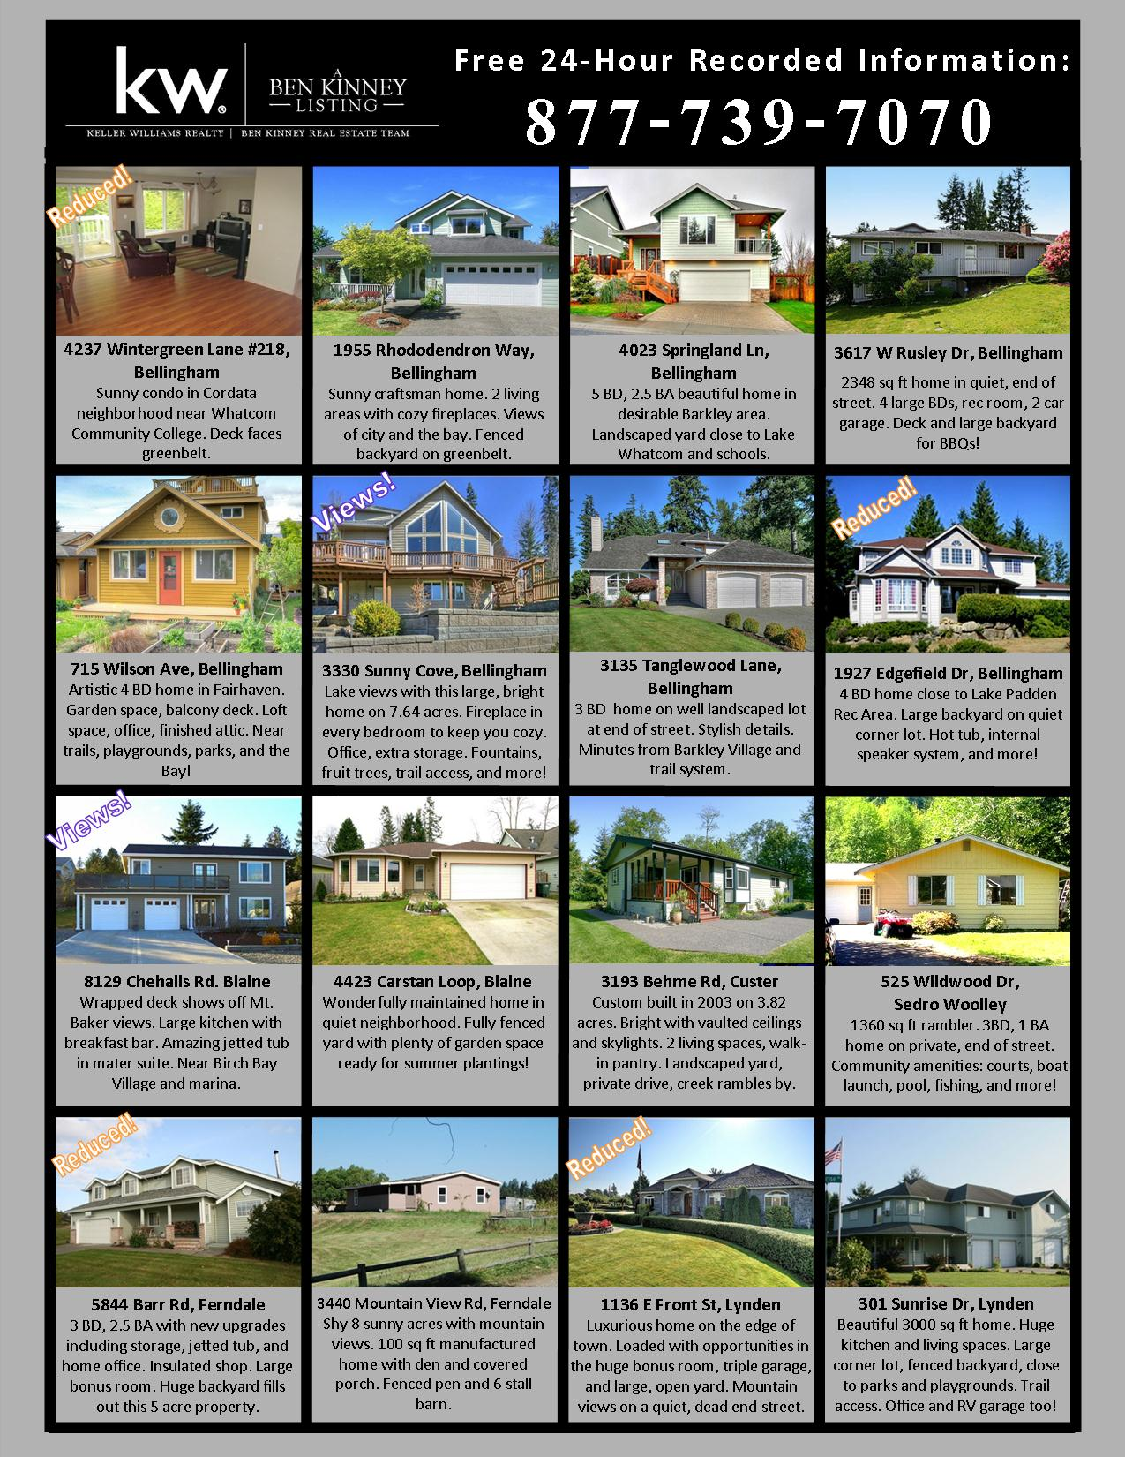
Your logo
Your logo

Slide 33
Open Houses

Slide 34

7%

Slide 35
Other

Slide 36

Agents
3%

Slide 37
Print

Slide 38

3%

Slide 39


Slide 40
Is there anything that another agent has said that they would do that I forgot to mention?

Slide 41
Commissions and Marketing Fees
Notes:
Intro slide

Slide 42
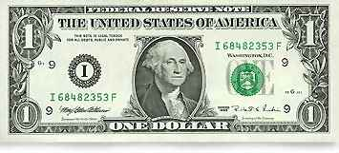

Slide 43
Agent that brings the buyer

Slide 44
What I get for marketing your property

Slide 45
Goes to the brokerage
Notes:
EXPLAIN THE WHEEL

Slide 46
Goes to marketing and servicing the listing

Slide 47
Is what I live on and get paid for my time working on the sale

Slide 48
